Slide 1
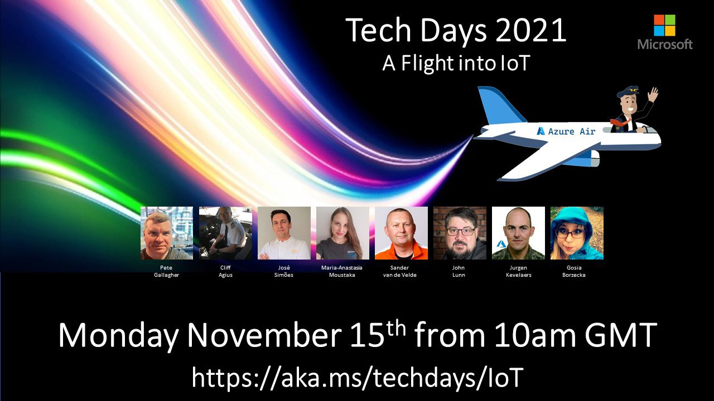
TSI
Sander van de Velde

Slide 2
We see incoming data in the IoT Hub What now?
Questions pop up:
From a Data Scientist perspective:
I want to see if there is a certain trend in the data
I want to check for certain anomalies
I want to see if I have a solid base for certain reports
- From an IoT Developer perspective:
Is there any telemetry coming in?
What telemetry is currently arriving?
Can I check the telemetry for a possible issue?
Can I compare flights over time?
Can I look at all telemetry of that one flight, 15 years ago?

Slide 3
We need an End-to-end analytics platform
To monitor, analyze, and visualize your (industrial) IoT data at scale
We would like to store the incoming data for historical purposes
Check the quality of ingested data
Generate charts, heatmaps, scatter maps, shifting time for comparison, add calculations
Doing some preliminary investigations to confirm suspicions
Setup Basis alerts (eg. when no data is ingested anymore)
Something like an Operational Historian in the cloud

Slide 4





Azure Time Series Insights (TSI)
A fully managed (platform as a service - PaaS) solution built for IoT
Ingest, process, store, query, and visualize
highly contextualized, time-series-optimized, IoT data at scale
Connect to a variety of data solutions
using TSI’s flexible data platform
Use rich analytics APIs and UX
for ad-hoc exploration and operational intelligence
Use JavaScript SDK
for building custom analytics apps on the TSI platform
Automated scaling and pay-as-you-go pricing
Turn data into decisions with actionable real-time IoT insights

Slide 5



Azure Time Series Insights pay-as-you-go high-level architecture
Ingest
Store
Model
Analyze
</>
COLD STORE ADLS Gen 2/ Azure Blob
Azure Event
Hub
Time Series Model
Time Series Query API
Time Series Insights Explorer
Power BI Connector
3rd PARTY APPS
Azure IOT
Hub
Azure Digital Twins
Ingestion processing
WARM STORE ADX
</>
TSM Update API
Timeseries data
API requests/returns
AI/ML workflow
Notes:
Once Time Series Insights is up and running, new data is synced continuously via the TSM Update API, providing you near real-time visualizations of your streaming data. You can also send logical twin models and device twin models directly to the TSM Update API for seamless integration into the Time Series Model.
Transition: Does Time Series Insights support AI and machine learning? (click)

Slide 6
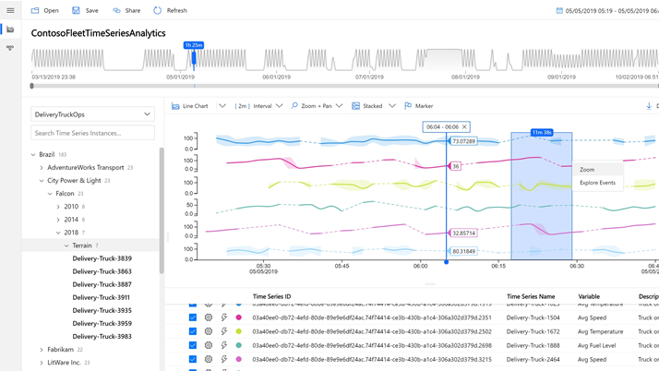
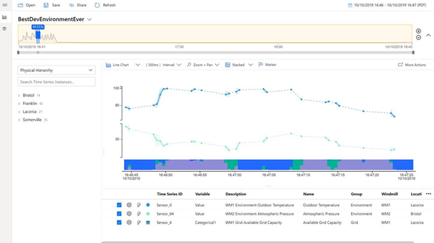
Azure Time Series Insights
Key capabilities
Multi-layered storage with warm and cold analytics support allowing customers to store data on warm store for interactive analytics over short timespans and to cold store for operational intelligence over decades of historical data
Data contextualization allows customers to describe the domain and metadata associated with the derived and raw signals from assets and devices
Flexible data platform that allows customers to take data stored in open-source Apache Parquet to other advanced data analytics solutions such as Spark, Databricks, machine learning, and AI
Rich query APIs and user experience to support signal reconstruction for missing data, reduction operations, discrete signal processing, scatter plots, and time shifting of time series signals for in-depth analysis
Enterprise-grade scale and performance at all layers of the solution to support customers’ industrial IoT solution needs
Rich extensibility through powerful connectors enables customers to take their time series data and consume them with other business systems
Notes:
Data first contextualization – model later if you’ve got new data showing up in your streams

Slide 7

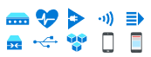


Anomaly detection and diagnosis
Uncovering the why:
3rd Party IoT apps using Time Series Insights APIs
Examples:
Understanding why equipment requires extra maintenance
Searching why inventory was damaged
Researching why production declined on an assembly line
Chasing down a defect in the supply chain process
Query API
IoT device, gateway, and application data
Azure IoT Hub
Time Series Insights
Time Series Insights JavaScript SDK
Time Series Insights Explorer
Notes:
We showed you one common use case for Time Series Insights- It’s all about uncovering Why something happened. What was different this time that produced another result.
TSI is primed for these use cases because:
No upfront data preparation needed
Connect to billions of events in Azure IoT Hub or Azure Event Hub, and visualize & analyze billions of events to spot anomalies and discover hidden trends in your data
Simple and easy to use exploration experience, while at the same time providing granular text-based querying for advanced users who are familiar with SQL
Perform DevOps analysis to get to the root cause of a bug in an IoT solution or identify areas to investigate for data science initiatives

Slide 8
Demo

Slide 9






Operational intelligence and advanced analytics
Improving operations:
3rd Party IoT apps using Time Series Insights APIs
Query API
Examples:
Monitor equipment performance at scale
Identify process inefficiencies
Diagnose the health of equipment
Optimize supply chain and production
IoT device, gateway, and application data
Azure IoT Hub
Time Series Insights
Time Series Insights JavaScript SDK
Time Series Insights Explorer
Advanced Analytics
Azure Batch
Databricks
Machine Learning
Self serve models
Predictive AI dashboards
Statistical analysis
Notes:
We showed you one common use case for Time Series Insights- It’s all about uncovering Why something happened. What was different this time that produced another result.
TSI is primed for these use cases because:
No upfront data preparation needed
Connect to billions of events in Azure IoT Hub or Azure Event Hub, and visualize & analyze billions of events to spot anomalies and discover hidden trends in your data
Simple and easy to use exploration experience, while at the same time providing granular text-based querying for advanced users who are familiar with SQL
Perform DevOps analysis to get to the root cause of a bug in an IoT solution or identify areas to investigate for data science initiatives

Slide 10


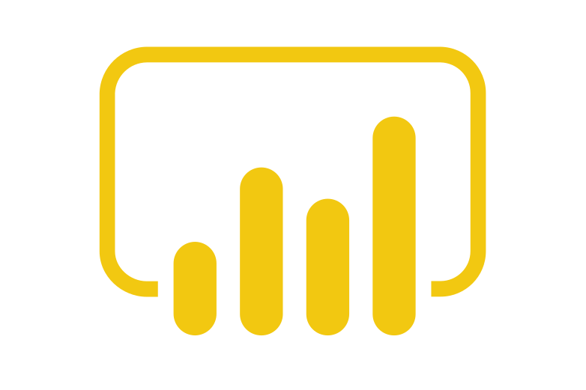



Operational intelligence and advanced analytics
Stream processing
Improving operations:
Operational efficiency
Azure Stream Analytics
Azure Logic App
Real time dashboards
Examples:
Monitor equipment performance at scale
Identify process inefficiencies
Diagnose the health of equipment
Optimize supply chain and production
Real-time
Event Hubs
Real time applications
Query API
IoT device, gateway, and application data
Azure IoT Hub
Time Series Insights
Time Series Insights Explorer
Advanced Analytics
Business systems (structured)
Azure Batch
Databricks
Machine Learning
Self serve models
Predictive AI dashboards
Statistical analysis
Notes:
We showed you one common use case for Time Series Insights- It’s all about uncovering Why something happened. What was different this time that produced another result.
TSI is primed for these use cases because:
No upfront data preparation needed
Connect to billions of events in Azure IoT Hub or Azure Event Hub, and visualize & analyze billions of events to spot anomalies and discover hidden trends in your data
Simple and easy to use exploration experience, while at the same time providing granular text-based querying for advanced users who are familiar with SQL
Perform DevOps analysis to get to the root cause of a bug in an IoT solution or identify areas to investigate for data science initiatives

Slide 11
Q&A
Links with further resources:
MS Learn module https://docs.microsoft.com/en-us/learn/modules/explore-analyze-time-series-insights/?WT.mc_id=IoT-MVP-5002324
Time Series Insight Documentation https://docs.microsoft.com/en-us/azure/time-series-insights/?WT.mc_id=IoT-MVP-5002324
Azure IoT Show – Deep Dive https://channel9.msdn.com/Shows/Internet-of-Things-Show/Deep-Dive-Analyzing-IoT-data-using-Time-Series-Insights?WT.mc_id=IoT-MVP-5002324
AZ 220 Reference https://docs.microsoft.com/en-us/learn/certifications/exams/az-220?WT.mc_id=IoT-MVP-5002324
Notes:
Process real-time data by using Azure Time Series Insights
* create a Time Series Insights environment
* connect IoT Hub and the Time Series Insights environment
* create a reference data set for a Time Series Insights environment by using the Azure portal
* implement Time Series Model hierarchies, types, and instance fields
* consume data by using Time Series Expression syntax

Slide 12
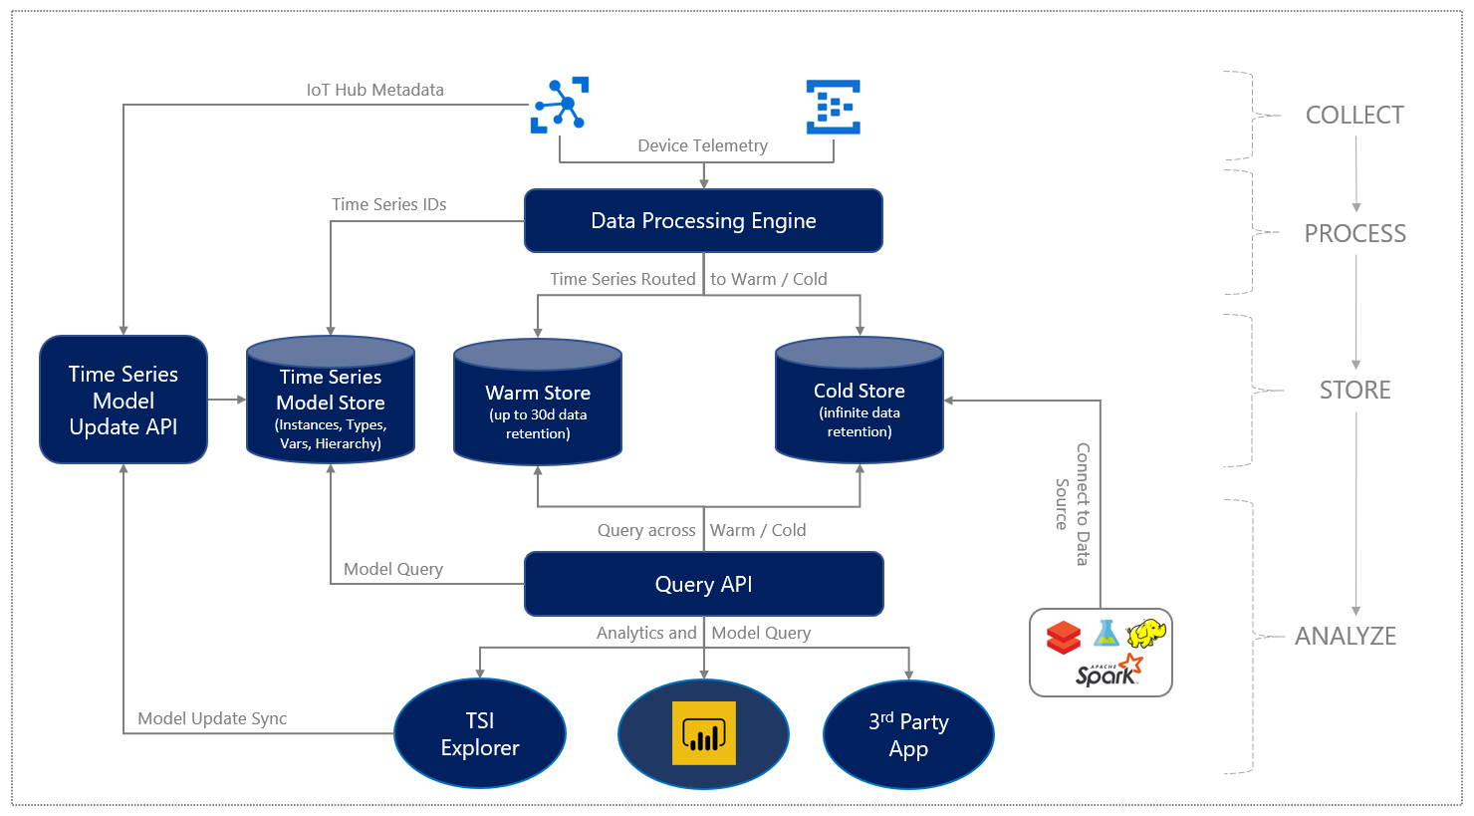
high-level data flow

Slide 13
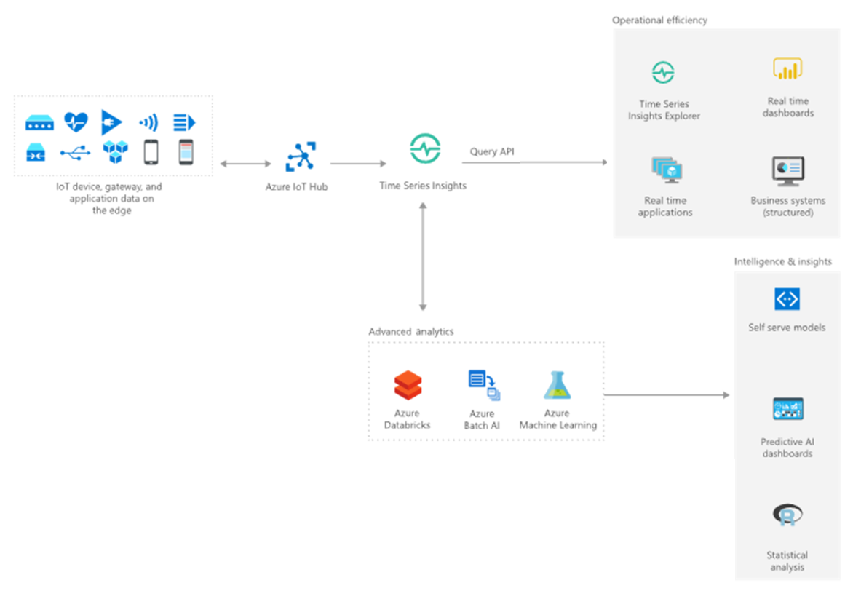
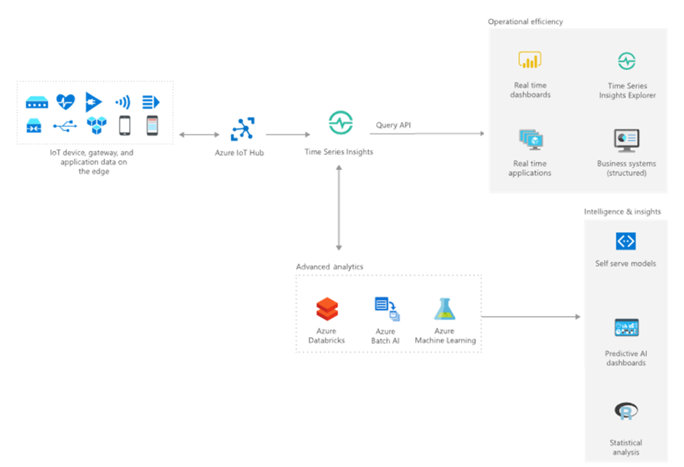
First usecase

Slide 14
Who am I?

Slide 15
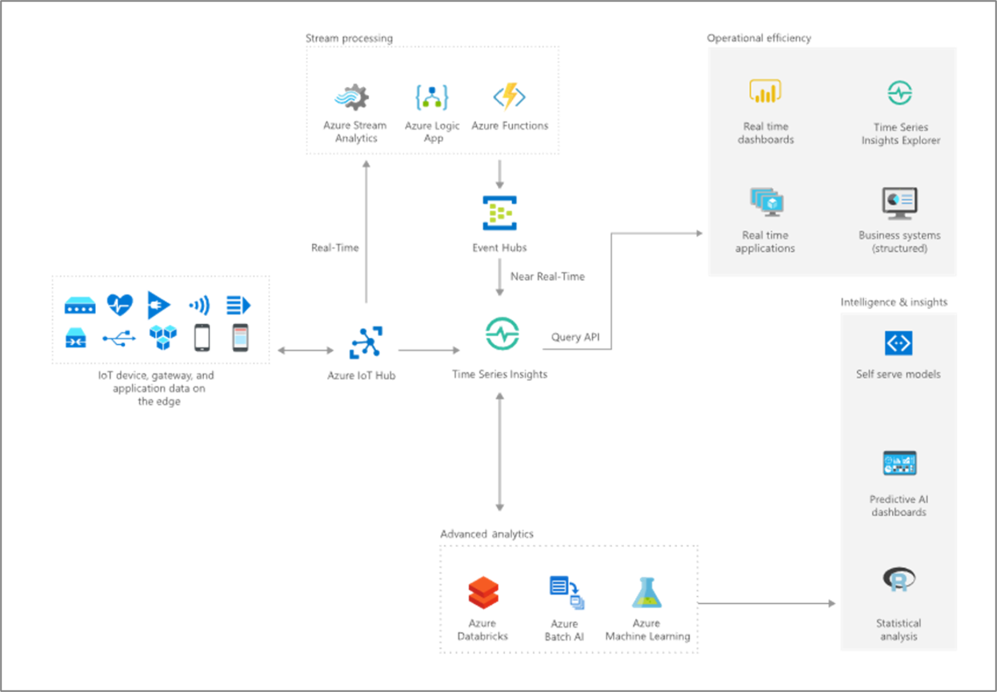
More elaborate use case (out of scope for today)

Slide 16
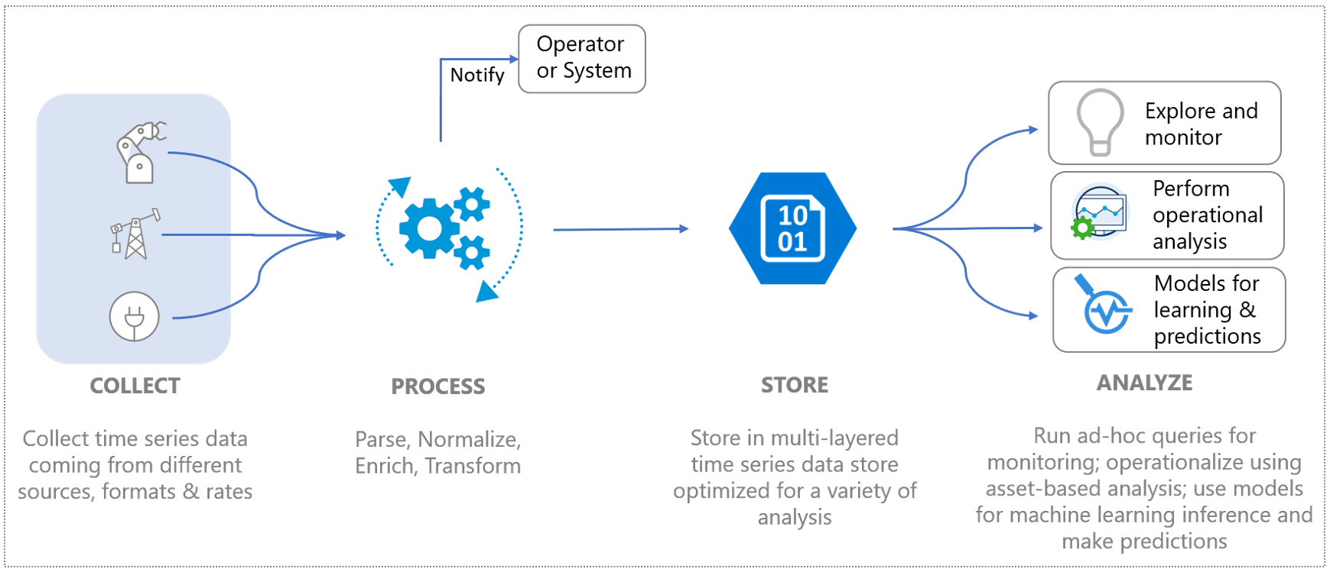
Azure resource: Time Series Insights

Slide 17
Features
Near real-time data exploration
Multilayered storage for IoT-scale time series data
Time Series Model to contextualize raw telemetry and derive asset-based insights
Smooth and continuous integration with other data solutions using APIs
Custom applications built on the Azure Time Series Insights Gen2 platform
Pay-as-you-go

